Slide 1
TITANIC DATA VISUALIZATION
EXPLORATORY DATA ANALYSIS WITH PLOTS

Slide 2
Overview of the Titanic Dataset
The Titanic dataset includes demographics and passenger information from 891 of the 2,224 passengers and crew on board the Titanic.

Slide 3
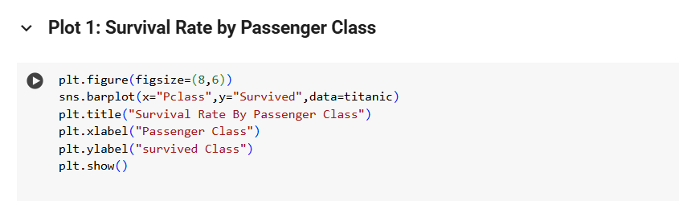
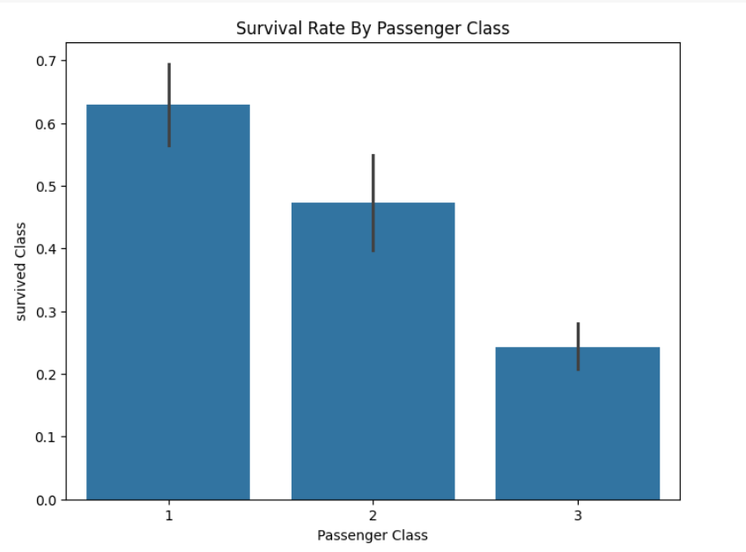
Insight: Higher classes (1st class) typically have higher survival rates, possibly due to better access to lifeboats and other safety mechanisms.

Slide 4
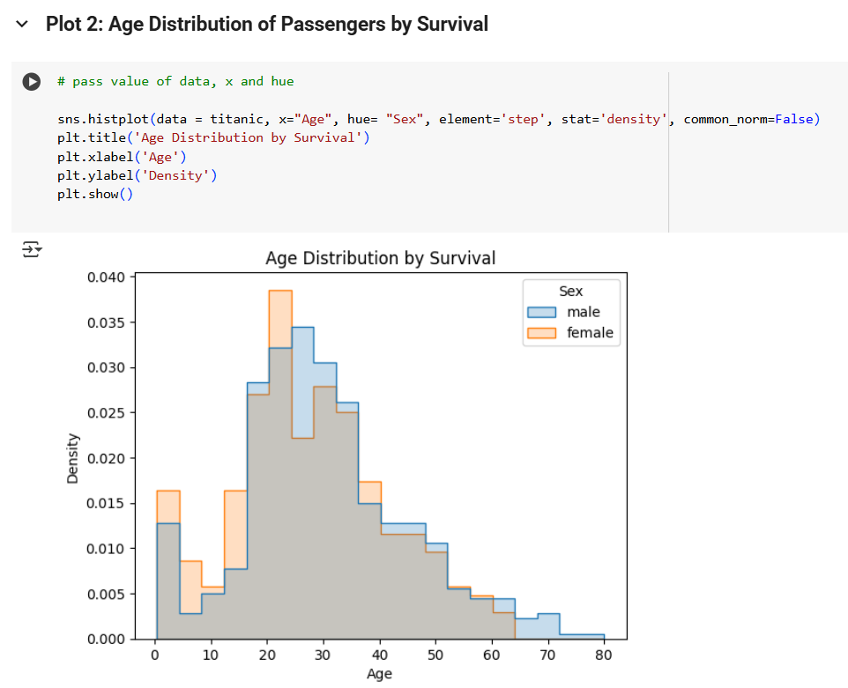
Insight: Younger passengers tended to survive at higher rates than older passengers, with children having notably higher survival rates, indicating possible prioritization of children in rescue efforts.

Slide 5
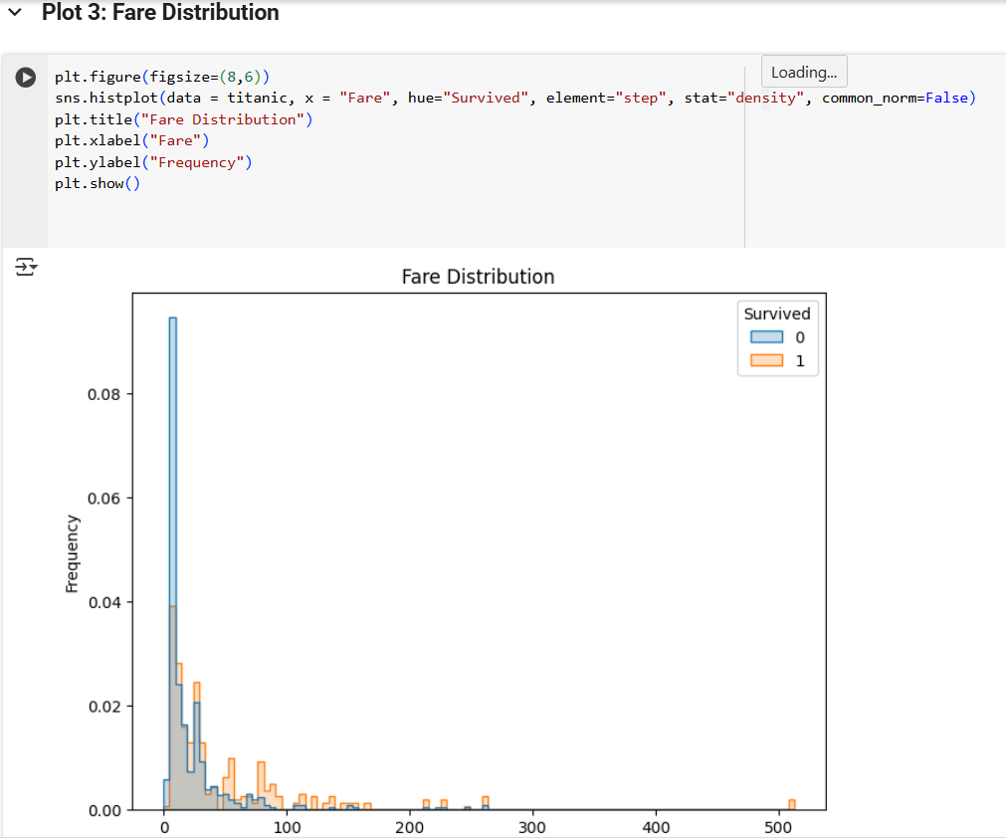
Insight: Passengers who paid higher fares, which likely correlates with higher passenger class, had better survival rates. The fare distribution is right-skewed, showing that most passengers paid lower fares.

Slide 6
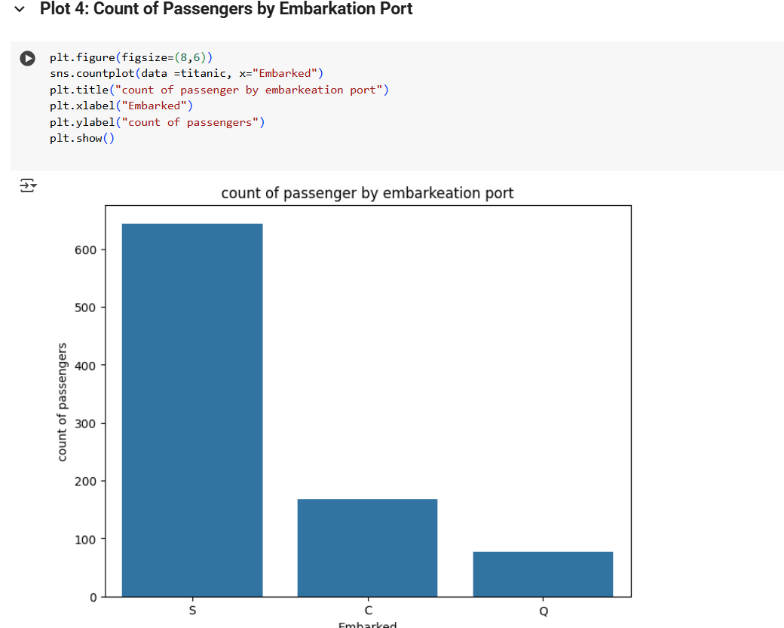
Insight: Most passengers embarked from Southampton, which was the Titanic’s point of departure. This could influence survival rates and demographic patterns observed on board.

Slide 7
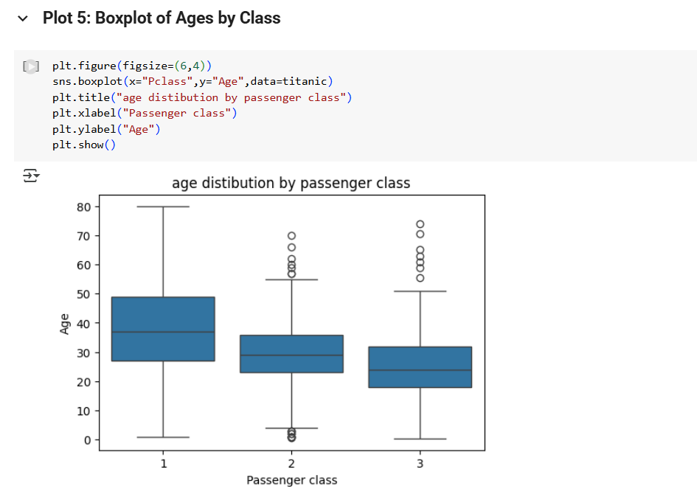
Insight: First class passengers tended to be older than those in third class, suggesting that wealthier, more established individuals were more likely to afford first-class accommodations.

Slide 8
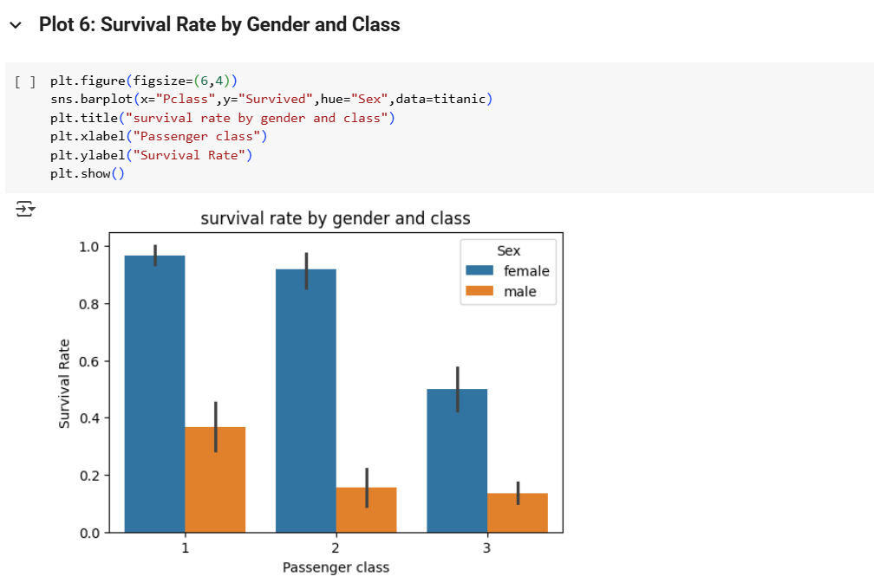
Insight: This plot typically reveals that women had higher survival rates than men across all classes, with the highest survival rates among women in the first class, highlighting the "women and children first" policy and social norms of the era.

Slide 9
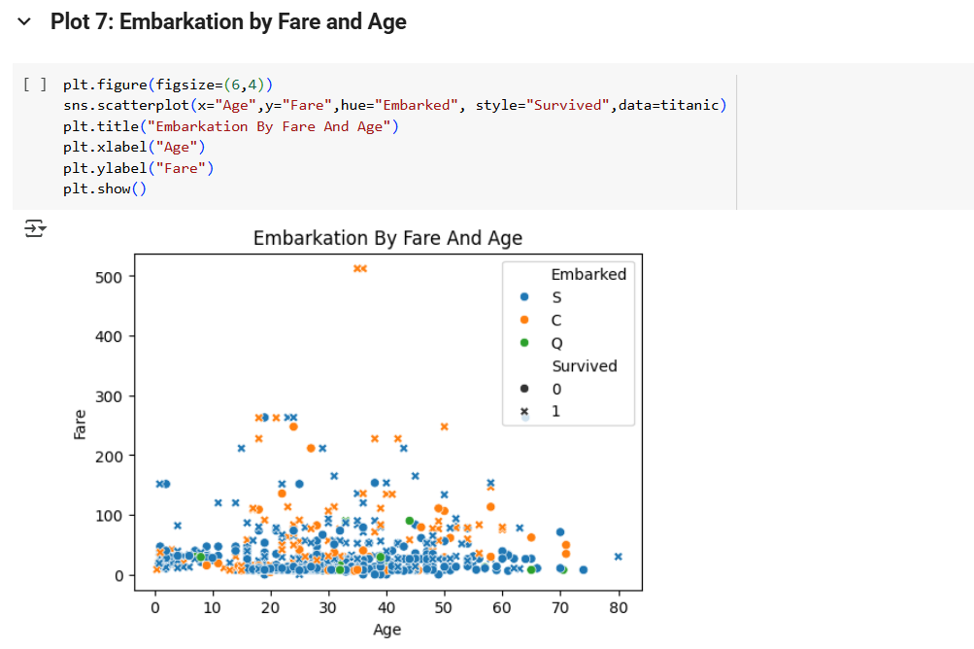
Insight: This plot can show if passengers from certain ports paid more and were older or younger, which may correlate with the economic conditions of those ports or the passenger strategies for securing Titanic tickets.

Slide 10
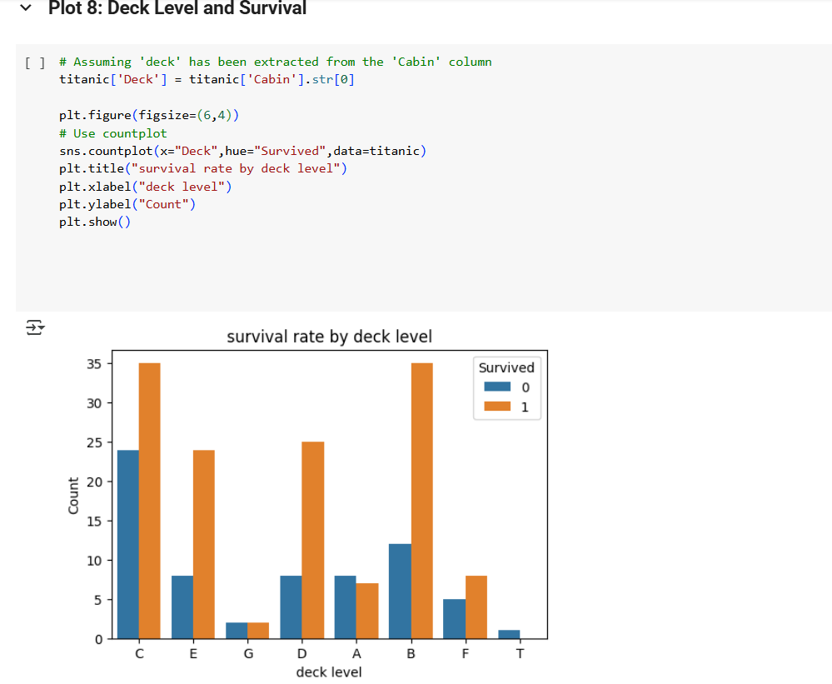
Insight: Passengers on higher decks may have had better access to lifeboats, thus higher survival rates, indicating the importance of cabin placement.

Slide 11
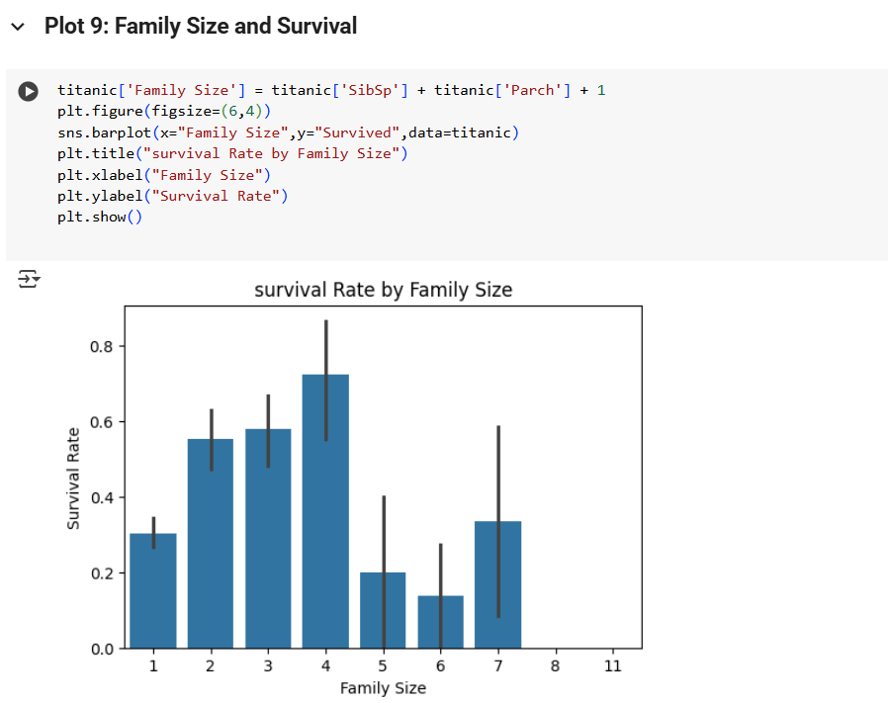
Insight: Medium-sized families might have had higher survival rates due to better support systems, while those traveling alone or with very large families might have faced more challenges.

Slide 12
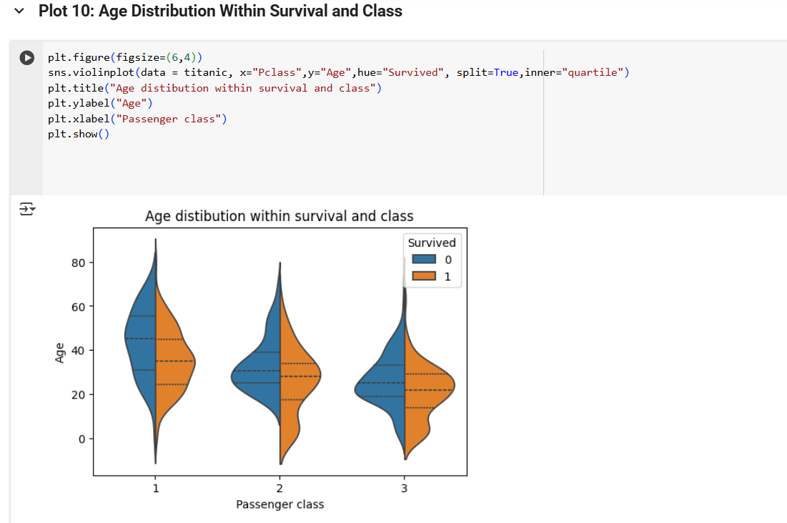
Insight: This plot may reveal if younger or older passengers in certain classes were more likely to survive, possibly due to their physical ability, location of cabins relative to lifeboats, or the prioritization of rescue efforts.

Slide 13
SUMMARY
Women had a higher survival rate than men.
First-class passengers were more likely to survive.
- Age and embarkation port showed subtle patterns.

